Slide 1
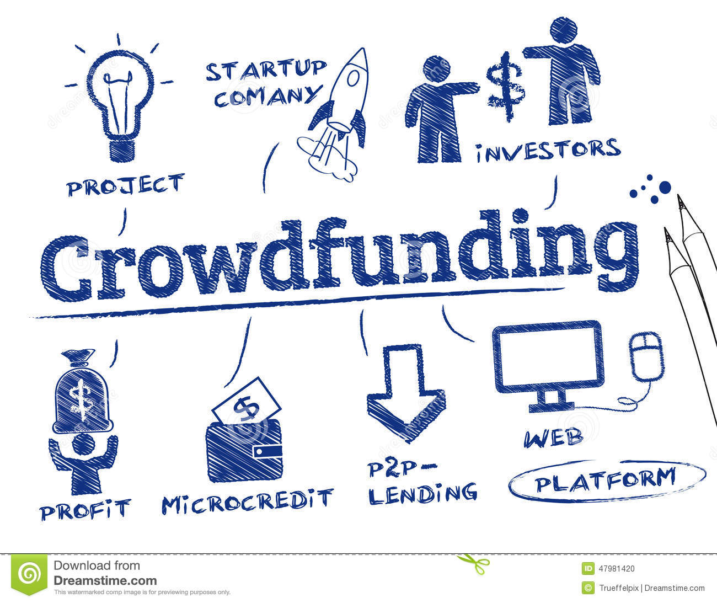

Predicting success of crowdfunding campaigns on Kickstarter
Project by:
(Group 3 Section 002)
Vallabh Reddy
Utkarsh Singh
Rinisha Marar
Soumya Halder
Saurabh Wani

Slide 2
Text mining on the description field helps increase the overall accuracy significantly (by >5% with logistic regression) – click to see results
Goal amount is the most important determinant of success rate. Higher the goal, lower are the chances of success. Time taken to design the campaign, the category and subcategory of project, the ease of readability of the description and the day of launch are some other important factors – click to see results
Successful creators take longer to prepare their campaigns but run it for a shorter duration – click to see results
After the campaign is launched, the number of backers attracted so far becomes the primary determinant of success – click to see results
A Random Forest model provides the best overall accuracy – 75% and 92% accuracy for pre and post campaign launch predictions respectively – click to see results
Executive summary

Slide 3
Kickstarter, launched in April 2009, is an online crowd-funding platform for entrepreneurs to raise funds from the online community
Project creators from across 22 countries can launch campaigns that are open to backers all over the world for funding
So far, Kickstarter has launched over 480,000 projects across 15 categories, collecting over USD 4.8 billion
Kickstarter charges a 5% commission on successfully funded projects
Project backers receive rewards in the form of limited-edition product copies, exclusive user experiences etc. in return (It is not an equity-sharing model)
Background
Source : https://www.kickstarter.com/help/stats

Slide 4
A campaign is featured as a “success” only if the entire goal amount is pledged
Category | Projects launched | Total amount pledged ( USD Million) | Success rate
All | 186,004 | 2,248.90 | 54%
Art | 20,073 | 79.82 | 55%
Comics | 6,988 | 63.67 | 80%
Crafts | 6,415 | 15.76 | 37%
Dance | 3,168 | 13.30 | 76%
Design | 6,945 | 219.67 | 56%
Fashion | 10,467 | 117.62 | 56%
Film & Video | 26,243 | 264.54 | 56%
Food | 13,219 | 81.30 | 29%
Games | 11,935 | 353.05 | 61%
Journalism | 3,670 | 10.10 | 20%
Music | 26,354 | 133.93 | 65%
Photography | 6,609 | 34.41 | 36%
Publishing | 18,671 | 126.20 | 67%
Technology | 19,812 | 711.40 | 36%
Theater | 5,435 | 24.13 | 60%
Overall statistics
Above figures are calculated from a sample of 186,000 campaigns
Data source : https://webrobots.io/kickstarter-datasets/

Slide 5
Project creation involves key decision-making steps
Important Measures
Conceptualize
Set targets
Plan launch
Pick a project name
Create description(“blurb”)
Upload videos, photos, demo tools
Build and grow online/offline network
Link Ad pages
Link social media pages, channels, blogs etc,
Content effectiveness
Networking
Campaign design
Launch planning
Post-launch engagement
Pick a sub-category/theme that increases the chance of successful funding
Decide campaign duration
Set optimum goals (Amount requested)
Create a reward package
Plan week, day, time of launch to maximize initial views
Targeted notifications to followers
Curate content
Initiate follower network

Slide 6
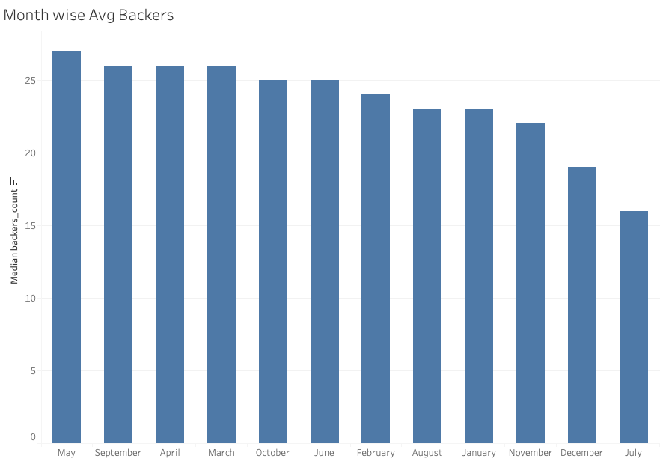
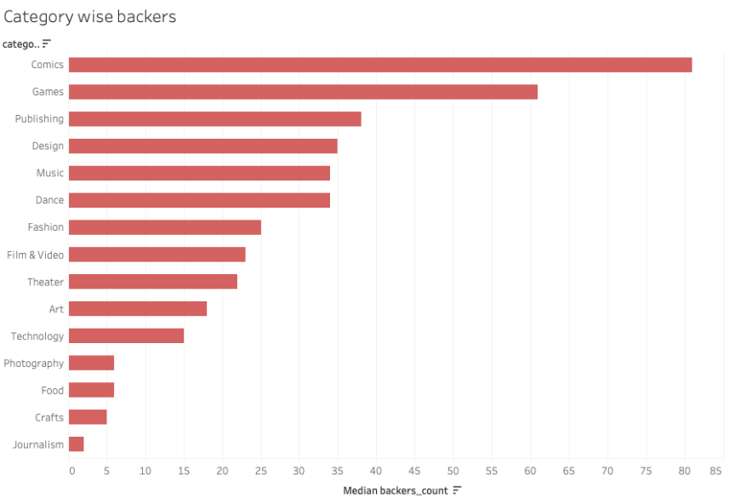
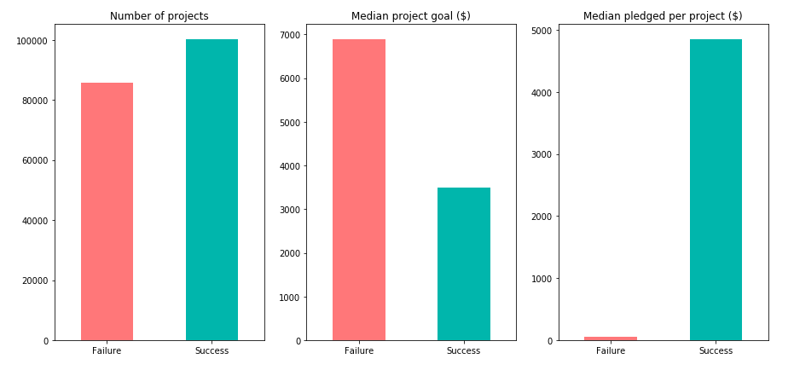
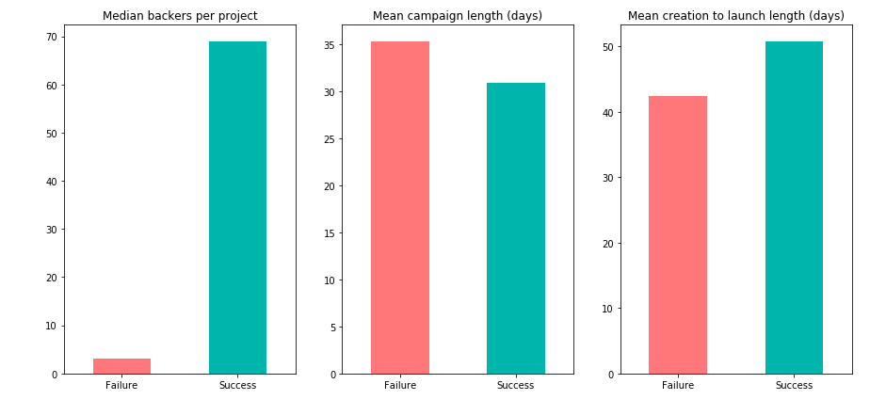
Initial EDA presents scope of increasing probability of success through data-driven decision making
Avg. number of Backers are least in July and highest in May
Comics is backed the most whereas Journalism is backed the least
Successful projects have a shorter average campaign duration
Avg. time taken to prepare the campaign (creation date to launch date) is also higher for successful campaigns
Month wise Average Backers
Category wise Backers
Key Metrics on Project’s success vs Failures

Slide 7
Illustration: Real examples
The following comparison of two projects in the music category illustrates how campaign attributes influence backers’ response
A failed project | A successful project
“Minister of peace crusade project” | “Northern hearts EP”
“Support my artistic movement of peace around the world using my music and spoken words and inspirational band……” | “ A five song folk-rock album”
Faith | Indie Rock
12000 USD | 2000 USD
35 days | 55 days
Debut campaign | 3 campaigns in the past
2 | 56
130 USD | 3600 USD
Project Name
Opportunity to utilize structured and unstructured data (text) mining techniques to establish drivers of success
Blurb
Sub-category
Goal
Campaign duration
Creator’s experience
No. of backers
Pledged amount

Slide 8
Project Scope: Identify factors that contribute to campaign success and predict success probability pre and post-launch
Problem statement
Objective
Approach
Identify key attributes of the campaign that determine success, and quantify their impact
Predict the probability of success
Recommend creators on planning campaign content and launch to maximize the probability of success
Identify projects that are below the threshold score for “success”, notify them about possible improvements
Create a recommendation framework based on the success propensity:
Estimate the probability of success before launch based on content uploaded
Suggest improvement tips for a good launch
Monitor response and refresh probabilities using a post-launch model with new predictors
Platform used: Python

Slide 9


Data overview: data collected on over 180,000 campaigns
Data available for dimension
* Campaign outcome (success/failure) used as response variable
Project creation
Content
Launch plan
Leading indicators
Creator ID
Location
Creation date
Project ID
Category/sub-categ
Description
Multimedia
Network
Ad/Social media pages
Reward
Launch date
Launch time
Notification list
# Backers
Amount pledged
Staff pick
Data source : https://webrobots.io/kickstarter-datasets/

Slide 10
Build two models to predict probability of success before and after launch
Pre-launch success prediction model
Identify shortcomings for recommendations
Post-launch success prediction model
Topic/Theme popularity
Use pre-launch campaign attributes such as Project theme, content quality, campaign creation time, planned duration and goal amount to predict probability of success
High
Medium
Low
Post the campaign launch, track leading indicators such as # backers, amount pledged, staff pick and additional predictors to refresh probabilities and revise recommendations
Content quality
High
Medium
Low
Goal feasibility
Optimal
Reasonable
Unreasonable
Campaign duration
Long
Medium
Short
Probability = 20%
Probability = 30%

Slide 11
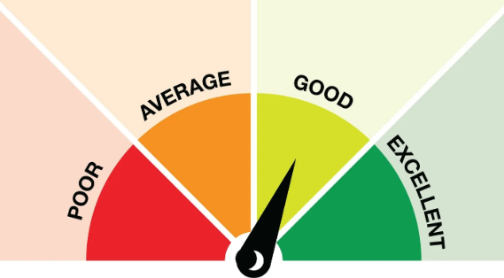

Use text mining to convert text data to predictors
Text fields
Project Name
Blurb
Outputs
Flesch readability score
Bag-Of-Words feature matrix ~ 2,500 features Language detection of blurb
NLP Algorithms

Slide 12
Steps for generating Bag-Of-Words feature matrix (Using sklearn and nltk)
Text cleaning
Remove punctuations
Remove stopwords
Remove words shorter than length of 3
Word stemming using PorterStemmer
Count vectorization
Transformation into a sparse array

Slide 13
Text Mining features improved the model performance significantly
Lift in overall accuracy obtained by including text features
Logistic Model: 4.8%
Random-Forest Model: 2 %
Neural Network: 0.6 %
In thissbhbdkjnscnsjlcn
bxhsbhbshcbshcbhcb
Logistic regression utilizes the text features most efficiently

Slide 14
Text Mining features improved the model performance significantly
Lift in overall accuracy obtained by including text features
Logistic Model: 4.8%
Random-Forest Model: 2 %
Neural Network: 0.6 %
In thissbhbdkjnscnsjlcn
bxhsbhbshcbshcbhcb
Logistic regression utilizes the text features most efficiently

Slide 15
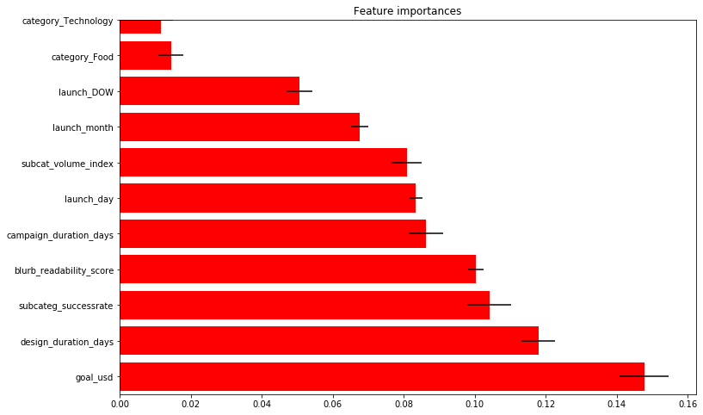
Random Forest variable importance result (Pre-launch model without Bag-of-words text feature matrix)
Variable importance plots
The goal amount is the most important predictor followed by the campaign design duration (days), subcategory success rate and the blurb readability score

Slide 16
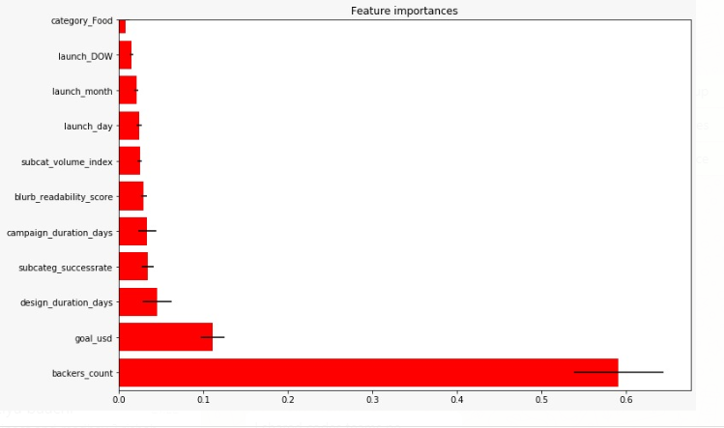
Random Forest variable importance result (Post-launch model)
Variable importance plots
Once the campaign is launched, the number of backers attracted so far becomes the primary determinant of success

Slide 17
Model validation, testing, performance metrics (*Models include text features)
Logistic Regression
Random Forest
Neural Network
Pre-launch model (Out of Sample):
Accuracy : 71.4% (AUC 0.72) Post-launch model (Out of Sample):
Accuracy : 78.5% (AUC 0.79)
Pre-launch (Out of Sample):
Accuracy : 75% (AUC 0.74)
Pre-launch (Out of Sample)
Accuracy : 70% (AUC 0.78)
Confusion Matrix |  | Prediction
 |  | Failure | Success
Actual | Failure | 10872 | 6388
 | Success | 4246 | 15694
Confusion Matrix |  | Prediction
 |  | Failure | Success
Actual | Failure | 11835 | 5212
 | Success | 3997 | 16156
Confusion Matrix |  | Prediction
 |  | Failure | Success
Actual | Failure | 15429 | 6865
 | Success | 4609 | 10297
Post-launch (Out of Sample):
Accuracy : 92% (AUC 0.90)
Post-launch (Out of Sample):
Accuracy : 90% (AUC 0.91)
Confusion Matrix |  | Prediction
 |  | Failure | Success
Actual | Failure | 12760 | 4500
 | Success | 3498 | 16442
Confusion Matrix |  | Prediction
 |  | Failure | Success
Actual | Failure | 15042 | 2005
 | Success | 979 | 19174
Confusion Matrix |  | Prediction
 |  | Failure | Success
Actual | Failure | 15248 | 2134
 | Success | 1653 | 18165
Symmetric Misclassification rate
AUC
Model lift %
K-statistic

Slide 18
Develop a rule-based rubric on the basis of variable importance results
Categorize campaigns under “High”, “Medium” and “Low” risk of failure
Select “Medium” and “Low” risk campaigns and evaluate campaign attributes as per the rubric
Reach out to creators with targeted suggestions
Monitor early indicators : No. of backers, Staff pick flag, Percentage of goal pledged
Step 2
Recommendation
framework
Identify risky campaigns and suggest improvements to make before launch
70%
Risk of failure
Step 1
Step 3
Predict probability of failure before launch
Refresh predictions with post-launch model
Step 4
40%
Risk of failure
Track performance and revise recommendations

